Slide 1

Necessity of Chatting Hours for Team Building
-What Psychological Safety Is-
Composed By: Hayato Ishida
For Japanese version, click here
Updated On: 16 July 2024

Slide 2
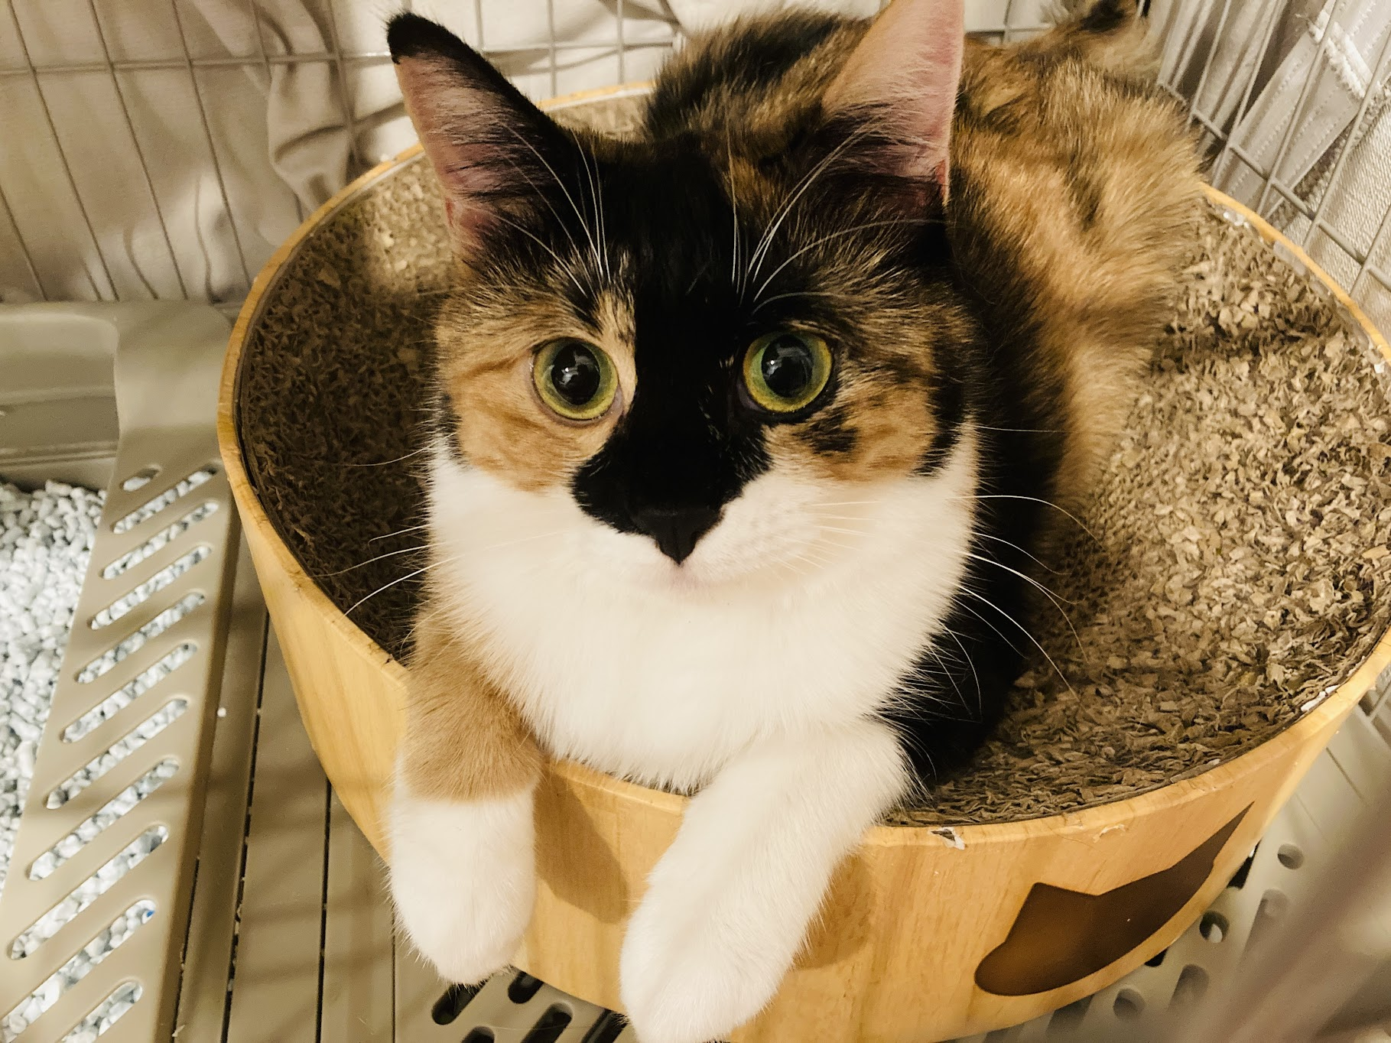
About Me
Accounts
GitHub: @hayat01sh1da
X: @hayat01sh1da
LinkedIn: @hayat01sh1da
Speaker Deck: @hayat01sh1da
Docswell: @hayat01sh1da
Occupation: Software Engineer
Things I Am Into
Linguistics
Singing at Karaoke
Listening to Music
Watching Movies
Cat Feeding

Slide 3
Licences / Certifications
English
TOEIC® Listening & Reading 915: Certified on December 2019
Engineering
Information Security Management: Certified on November 2017
Applied Information Technology Engineer: Certified on June 2017
Fundamental Information Technology Engineer: Certified on November 2016
IT Passport: Certified on April 2016
Others
Abacus 2nd Class: Certified on June 2002
Mental Arithmetic 3rd Class: Certified on February 2001

Slide 4
Skill Stack
Languages
Japanese: Native Proficiency
English: Full professional Proficiency
Development
Backend: Ruby(Ruby on Rails), Python
Frontend: TypeScript + React.js, TypeScript +Vue.js
Database: MySQL, PostgreSQL, MongoDB
Architecture: Monolith, Modular Monolith
Hosting: AWS ESK
Versioning: Git, GitHub
CI/CD: GitHub Actions, ArgoCD
Monitoring: Datadog, Sentry

Slide 5
Work Histories
Period | Genre | Position | Jobs
Aug 2021 - Present | Saas(Educational Service) | Software Engineer | Backend Development Frontend Development CI/CD Maintenance Weekly Release Manager Troubleshooting Documentation Technical Debt Resolution Tech Blog Entries LT Speaker
Feb 2020 - Dec 2020 | SaaS(Chatbot Platform) | Backend Engineer | Backend Development Documentation Technical Debt Resolution Inspection of Alternative API

Slide 6
Work Histories
Period | Genre | Position | Jobs
Jun 2018 - Jan 2020 | Contract-basis Developer | Software Engineer | Backend Development Frontend Development Troubleshooting Quality Assurance Tech Blog Entries
Apr 2016 - Jan 2018 | System Engineering Service | System Engineer | Corporate Account Admin Windows Server Maintenance Security Admin Assistant Internationalisation / Localisation

Slide 7
International-Exchange Activities
Activities in University
English Linguistics Seminar(Focusing on Mass Media English)
International-Exchange Clubs(The 2nd Year)
International-Exchange Programmes conducted by Japan Cabinet Office(2013 - 2016)
Japanese Linguistics Course(The Final Year)
Overseas Life Experience
Working Holiday in Australia(April 2014 - March 2015)
Language School for 1 month in Sydney
Work for 6 Months in Hamilton Island Resort
Volunteering for 1 Month as Assistant Teacher of Japanese Language at St Ives High School in NSW
Other Activities
Keep Everyday Journal in English (April 2014 - Present)
Sunrise Toastmasters Club(February 2017 - March 2018)
Vital Japan(January 2018 - July 2019, October 2022 - February 2023)
Self Learning and Training of English Language
Participation Ruby-Related Tech Conferences

Slide 8
Agenda
Prologue
What Psychological Safety Is
Psychological Safety at Your Workplace
Top 3 Requirements for Psychological Safety
How to Grow Psychological Safety
Effectiveness of Chatting Hours
Feedback from Members of My Team
Summary
References

Slide 9
1. Prologue

Slide 10
1. Prologue
Our team holds a chatting hour from 15:00 to 16:00 every Wednesday.
We adopt Scrum as a development method and have DS(Daily Standup) for 30
minutes in the morning of every business day.
Each member shares the following items other than status of SBIs(Spring Backlog Items) generally managed.
Other Tasks than SBIs
Handling enquiries, Documents to submit etc.
Business Concerns, Bothers
Request for sharing expertise or technical/domain knowledge etc.
Private Concerns
Weekend outing, Child bearing, Favourite sweets etc.

Slide 11
1. Prologue
As the number of team member has increased, duration for sharing private concerns has been incremented and DS often failed to be closed within the allocated time.
It was the trigger to have the chatting hour to focus on and discuss only private events.
Sharing private concerns is the only change to know characters of other members. In other words, securing psychological safety allows us to have a frank business discussion, which ultimately leads to team building.
However, I came to wonder if this chatting hour really worked as an icebreaking
activity because I had been feeling stressed out.

Slide 12
1. Prologue
What brought me such ambiguous stress?
It turned out later on that the following 3 elements are closely related to the cause.
First of all, what is psychological safety?
What requirements secure psychological safety?
How can we grow psychological safety?
Looking closer at the factors above, I contemplate the necessity of the chatting hour as an icebreaking activity and shared my opinion with other team members. Here, I will share what I deliberate and feedback from them.

Slide 13
2. What Psychological Safety Is

Slide 14
2. What Psychological Safety Is
Quote
Psychological safety means feeling safe to take interpersonal risks, to speak up, to disagree openly, to surface concerns without fear of negative repercussions or pressure to sugarcoat bad news. Psychological safety nurtures an environment where people feel encouraged to share creative ideas without fear of personal judgment or stepping on toes. In this kind of environment, it feels safe to share feedback with others, including negative upward feedback to leaders about where improvements or changes are needed. It's OK to admit mistakes, to be vulnerable, and to speak truth to power. When psychological safety is present in the workplace or at home, it creates a more innovative, stronger community.
Reference: ll.8-10, Sarah-Claire Jordan, Alpha Omega Translations

Slide 15
3. Psychological Safety at Your Workplace

Slide 16
3. Psychological Safety at Your Workplace
Psychological safety at workplace deeply depends on whether we can have a frank discussion with our stakeholders.
That is because our tasks tend to rather need close collaborations with someone else than be self-concluded regardless any division, title and position.
Important is to make sure that we must not identify the result of a discussion with humanity of the others.

Slide 17
3. Psychological Safety at Your Workplace
Let's see the following discussion.
The more the number of test cases increases, the longer lead time of CI(Continuous Integration) becomes, so I prefer to put the same assertions in a common context, but I would also idealistically like to separate them to each. This trade-off makes it hard to make only a right decision.
If update of a value is applied to all columns, the corresponding test case should be in a common context. However, this expects one of them to be updated, so values vary from column to column. That is why I prefer to put assertions separately.
As a result, B is taken in order to value the role as SPEC of the testing framework.

Slide 18
3. Psychological Safety at Your Workplace
The precedent character A and B discussed the trade-off between idealistic test case separation and CI lead time and tried to find the most reasonable answer.
In this context, they just insist each opinion with a supportive idea for a better solution and NEVER referred to each other's humanity.
Were the character A to think that the character B is unacceptable as a person since B's opinion does not get along with mine, what would happen?
Whether their opinions are the same or not, having a constructive discussion is the key point, but they would come to be alert to each other once they are sure to be evaluated based on the result of the argument.
It will absolutely prevent innovative ideas from emerging at all and establish too conservative an organisation of members make the best effort to protect themselves.

Slide 19
3. Psychological Safety at Your Workplace
Repeatedly, the most important is to make sure that we must not identify the result of a discussion with humanity of the others if we truly wish to secure psychological safety.
It seems self-evident for the organisations which adopt Scrum as a development method, the principle is definitely worth being articulated in Working Agreements.

Slide 20
4. Top 3 Requirements for Psychological Safety

Slide 21
4. Top 3 Requirements for Psychological Safety
Organising the essence from the quote and the contents of the last chapter, we will be sure that the following 3 requirements must be fulfilled.
To be able to be sure you are a member of the organisation.
You need the organisation while it needs you likewise.
To be able to frankly open your opinions and emotions to anyone else.
You are not be alert to the other based on each other's gender, nationality, title and position.
Not to be denied by the act 2 above.
There is an agreement that frankly sharing your opinions and emotions are separate from the evaluation of your humanity.
Never attack humanity even though the other's opinions or emotions are different from yours!

Slide 22
5. How to Grow Psychological Safety

Slide 23
5. How to Grow Psychological Safety
On the other hand, Top 3 Requirements for Psychological Safety mentioned in the last chapter is hard to be fulfilled without knowing what is who.
Having a chat over dinner or going out to play outside of work is going to be an effective means to produce psychological safety.
In any case, how much you understanding what is who totally depends on how
much communication you have the other.
That is to say, finding a common interest is the key to maximise the amount of communication.
In a 1 on 1 conversation, it is not so difficult, but the more people are concerned, the smaller the intersection of common interests become, which is a huge dilemma in the context of an organisation.

Slide 24
5. How to Grow Psychological Safety
Workplace is a community where those people gather who were born and raised on
different backgrounds but have the same business interests as follows.
Interest in development in a specific programming language
Interest in be in change of a specific service
Interest in be in change of all phrases from requirements definition, design, implementation, release to maintenance of an inhouse product
In the sense, we are highly likely to be able to find a common interest in business concerns.
You will rarely find someone who spends free time as you do and you are super lucky provided you found anyone.

Slide 25
6. Effectiveness of Chatting Hours

Slide 26
6. Effectiveness of Chatting Hours
To carefully analyse the scepticism and stress caused by the chatting hour mentioned in the prologue, the following 3 reasons turned up.
It is generous for a wide variety of topics including business concerns. However, it focused too much on private concerns, which minimised the intersection of common interests.
The tiny intersection catch interests of few members, so distribution of chances of speech was quite unfair.
As a result, it failed to maximise the intersection of common interests and play a role in icebreaking activity, but it provided uncomfortable atmosphere caused by awkward communication and frequent silence. It was going against team building.

Slide 27
6. Effectiveness of Chatting Hours
Whatever topic we set, important is to have an agenda which maximises the intersection of common interests.
A team good at a frank chat should have a small talk, but the other team not good at it ought to have a talk about the
following affairs.
Business Tips
Share twists and effective tools at work etc.
Upcoming PBIs(Product Backlog Items)
Casually talk about items not supposed to be worked on this sprint
The excuse of a chatting hour allows us to hit on something creative or productive with flexibility.
Technical News
Exchange information about programming languages or frameworks you make use of
Knowledge Source Sharing
Exchange information about technical blogs or learning sessions you usually watch
Discussion about Scrum development method
Opinions from other members than Scrum master are also important.

Slide 28
6. Effectiveness of Chatting Hours
My team members has the following personalities.
Hardworking
Not good at long-hour team conversation
No idea how good they are at personal conversation
Earnest to discussion about highly abstract concepts or technical affairs.
Not let unclear points be and willing to try hard to arrive at an agreement
Tries hard to discuss what is right or wrong and find the best solution considering trade-offs
That is why I suggest we should talk mainly about business concerns at a chatting hour one day.

Slide 29
7. Feedback from Members of My Team

Slide 30
7. Feedback from Members of My Team
Member A: It is hard to equally distribute changes of speech because it depends on how talkative each member is and what topic is provided.
Member B: It is painstaking to convey non-verbal elements in the case of remote work, so we have to articulate our opinions.
This is a required quality at work, so the activity can be made use of as a change for practice.
Member C: the activity was intended for blowing off steam, so private concerns should be focused on.
Not happy with being selective to the topic
Member D: It is enough to maintain the current situation and the activity can also play a role in Background Music or Podcast.
At least, members have got to agree that silence does not mean negative feedback.
GM(Group Manager): It is better to switch the speaker or topic once specific duration is over or the topic is exhausted.
Once members see speech as mandatory, members will not happy with joining the activity.
On the other hand, self-openness pulls a trigger for psychological safety.

Slide 31
7. Feedback from Members of My Team
There were disagreement about the following 2 points and I will provide my opinion to each.
Is the chatting hour for team building or blowing off steam?
We have it within business hours, so the activity must be for team building. To realise it, we should be selective to the topic in order to maximise the intersection of common interests.
If the activity is for blowing off steam, we do not have to gather all members and 1 hour is too long to spend as business hours.
Does anyone have a problem about psychological safety in the team?
If not, the activity is no more needed because team building targets establishment of psychological safety via icebreaking activities and mutual understanding.
If the activity is treated as fallback destination of sharing private concerns, keeping time DS is the best approach to take.
Exchanging opinion of implicit agreement made crystal what was the cause of scepticism and stress to the chatting hour, which may lead to any change next time.
I will keep carefully watching the activity for the next couple of times and say something unless I do not find any sign of improvement.

Slide 32
8. Summary

Slide 33
8. Summary
The chatting hour is only a means to secure psychological safety via icebreaking activity and mutual understanding.
The most important is to find the best way to maximise the intersection of common interests among your team members.
If no one has a problem about psychological safety, the activity is not needed.
To secure psychological safety requires the following 3 requirements to be
fulfilled.
To be able to be sure you are a member of the organisation.
To be able to frankly open your opinions and emotions to anyone else.
Not to be denied by the act 2 above.
3. We must not identify the result of a discussion with humanity of the others, which is the agreement any organisation must make.

Slide 34
9. References

Slide 35
9. References
What is Scrum? - AWS
Last Accessed On: 17 February 2024
What is psychological safety? - McKinsey & Company
Last Accessed On: 17 February 2024
Working agreements - ATLASSIAN
Last Accessed On: 13 November 2023

Slide 36
EOD

